Slide 1
The Future is on FHIR: Interoperability with HIMSS Innovator-in-Residence
Adam W. Culbertson, M.S., M.S. HIMSS Innovator-In-Residence HealthTechNet Dec. 15th 2017 Washington, DC
Contact: Aculbertson@himss.org
Notes:
© Culbertson 2017

Slide 2
Overview
Exemplars
APIs in Healthcare
FHIR and SMART
Tools and Resources

Slide 3
Exemplars

Slide 4
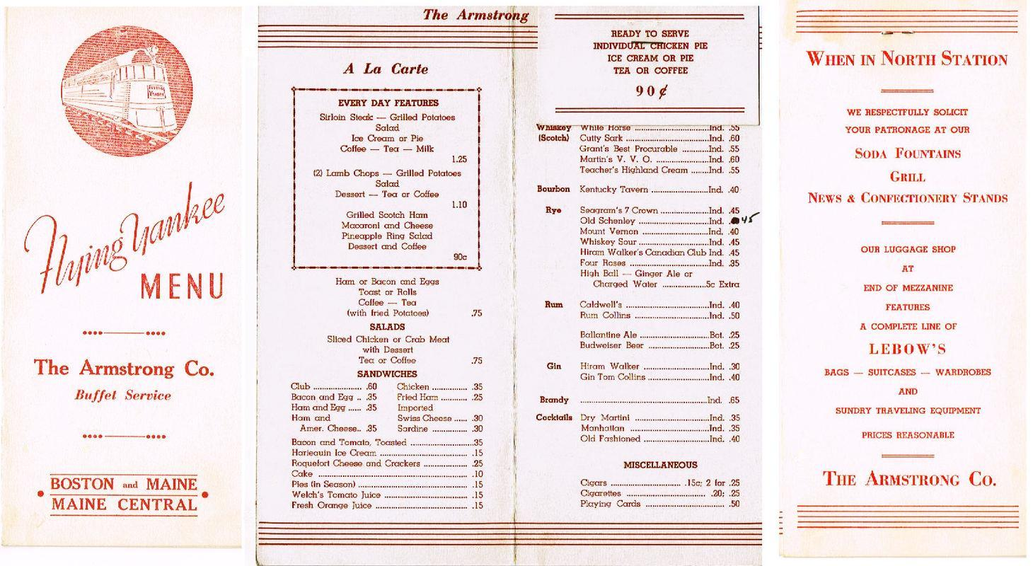
https://upload.wikimedia.org/wikipedia/commons/0/02/Flying_Yankee_menu.JPG
Notes:
https://upload.wikimedia.org/wikipedia/commons/0/02/Flying_Yankee_menu.JPG

Slide 5
Source:McCallie, David. “SMART on FHIR Apps for Healthcare.” Dev Con. July 1st 2014

Slide 6
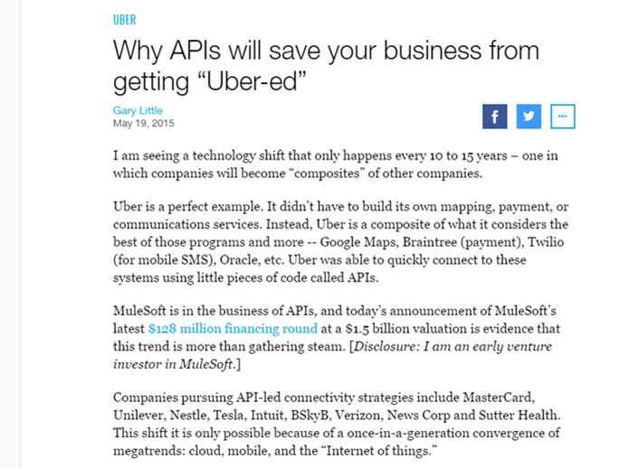

Slide 7
Leading Adopters of APIs
Uber
Leveraged APIs to build $60 billion dollar company
Used Google Maps API
Braintree Payment API
Twilio (for mobile SMS) API
http://fortune.com/2015/05/19/why-apis-will-save-your-business-from-getting-uber-ed/ accessed 2-17-17
Notes:
http://fortune.com/2015/05/19/why-apis-will-save-your-business-from-getting-uber-ed/
Uber is a composite
Google Maps
Braintree (payment
Twilio (for mobile SMS),
Oracle
Uber was able to quickly connect to these systems using little pieces of code called API
Uber has upended the global taxi industry in large part by using APIs masterfully
Traditional businesses rely on large sales forces, paperwork, and fax machines to generate revenue with customers and through partners.
UPS has captured a large share of the parcel-shipping market for the burgeoning online commerce sector by publishing an API – just a few lines of code – which makes it easy for shopping sites to integrate shipping seamlessly into their online check-out process.

Slide 8
APIs in Healthcare

Slide 9
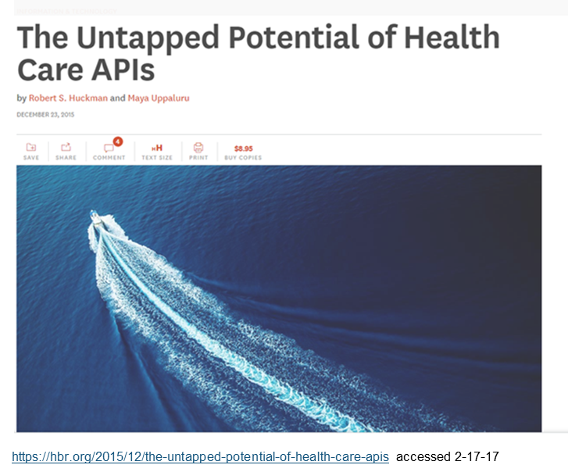

Slide 10
Source https://ehrintelligence.com/news/healthcare-apis-enabled-1-billion-exchanges-at-allscripts-in-2017

Slide 11
Why Now
Mobile Applications
Movement towards cloud based solutions
Changes in Value Based Payment
Regulatory Reforms
Meaning Use Requirements
21st Century Cures Act
“Publish application programming interfaces and associated documentation with respect to health information…(1)
1) https://www.congress.gov/bill/114th-congress/house-bill/6/text accessed 2-17-17

Slide 12
“EHRs are becoming commodity platform. The winner will be the EHR vendor that provides the best platform for innovation-the most open and most extensible platform.”
CEO of a major IDN
McCallie, David. “SMART on FHIR Apps for Healthcare.” Dev Con. July 1st 2014
Notes:
https://www.youtube.com/watch?v=BbBZbo2fMus
EHRs are becoming “Open Platforms” where developers can build applications on top of existing EHRs

Slide 13
FHIR and SMART on FHIR

Slide 14
What is ?
New take on healthcare data standards focused on Fast Healthcare Interoperability Resources (pronounced Fire)
From HL7 and data exchange standard
Uses Resources and modeled from HTTP protocol
Resources include patients, problems, prescriptions
Community
“FHIR is both a standard and a community.”
Grahame Grieve
Notes:
FHIR (pronounced like fire), Fast Healthcare Interoperability Resources, is a standards framework created by HL7, an organization that develops standards related to the exchange and sharing of electronic health data.
FHIR solutions are built from modular components in such a way that any EHR system can read extensions in app coding for seamless implementations.

Slide 15
What is ?
Designed by Developers for Developers
Draft → Working Standard from HL7 (ready to use!)
Licensed under Creative Commons “No rights reserved”
Technically two main pieces
Resources
Methods
Notes:
Clear and extensive documentation with examples
Encourages the use of puns and poor clip art

Slide 16
FHIR Resources
Data models representing discrete clinical and administrative units (patient, practitioner, allergy, medication order, etc.) around 100 current resources at various stages of development
Clinical Resources
Administrative Resources
Infrastructure Resources
JSON or XML
Each resource includes narrative text “lowest common denominator data exchange”
Don’t include the kitchen sink follows the 80/20 rule
“We only include data elements if we are confident that most normal implementations using that resource will make use of the element”
– Grahame Grieve
Source: https://www.hl7.org/fhir/resourcelist.html

Slide 17
https://www.hl7.org/fhir/resourcelist.html accessed 9/22/17
Notes:
Follow the 80/20 rule
If need more resources you can add an create an extension

Slide 18
Patient Resource Example

Slide 19
FHIR Request
GET
Used to get a specific resource such as a patient
POST
Can be used to post a lab to a patient EHR
DELETE
Used to Delete a record
HEAD
Same as get except server must not return anything in the body of message
PUT
Replace existing resource could be used to update a patients demographic data

Slide 20
FHIR Search API
Every FHIR Resource lives at a URL of the form:
http://fhir-open-api.smarthealthit.org/Patient/1032702
ENDPOINT
URL
Method
Eg GET
Method Resource [base url] Parameter
GET https://fhirtest.uhn.ca/baseDstu3/Patient?given=Lisa
&family=Colmean

Slide 21
FHIR Search API
Each FHIR Resource defines a set of search parameters
These parameters can be passed in the URL to limit which Resources are returned by the server
http://fhir-open-api.smarthealthit.org/Patient?gender=male
Resources are returned as a FHIR Bundle – an array of results with some metadata
The bundle may contain a subset of results with links to additional pages of resources (e.g. 1-50 of 300)

Slide 22
Martin, Ed. “Building Healthcare Apps Integrating with EHR using SMART-on-FHIR.” 8/28/17

Slide 24
SMART on FHIR
Substitutable Medical Applications Reusable Technology
“SMART Health IT is an open, standards based technology platform that enables innovators to create apps that seamlessly and securely run across the healthcare system.”
Developed at Harvard Medical School with the goal of developing plug and play medical apps.
Build once deploy multiple times
Plug and play interoperability
Mandel, Josh. “SMART An App Platform.”
Notes:
SMART project, Substitutable Medical Apps & Reusable Technology,
Funded by ONC's Strategic Health IT Advanced Research Projects,
In 2010, the SMART project received a four-year, $15 million grant from the ONC to conduct its research.
Two major goals: develop a user interface to allow substitutability for medical apps based on shared basic components and
create a set of services to enable efficient data capture, storage, retrieval and analytics.
create an ecosystem of substitutable apps that can run on any EHR system,"
Blending the two together, SMART on FHIR is the SMART project's latest platform offering whose vision is to provide the resources for developers to build medical apps using "developer-friendly APIs" that integrate into any EHR system at the point of care allowing for "plug and play" usability.

Slide 25
Standards based technology
Authorization & SMART Launch Context (OAuth)
Single Sign On (OpenID Connect )
Clinical Data API (FHIR)
Clinical Data Resources
(SMART / Argonaut Profiles)
Notes:
Users:
App choice (substitutability)
Developers:
Low barriers to entry (open standards, large community)
Single app can run in systems by different vendors
Single app can run in different contexts (e.g. EHR and Patient Portal)

Slide 26
The SMART Platform
Standards based technology stack
Open source tools and resources
Industry support
Public app gallery

Slide 27
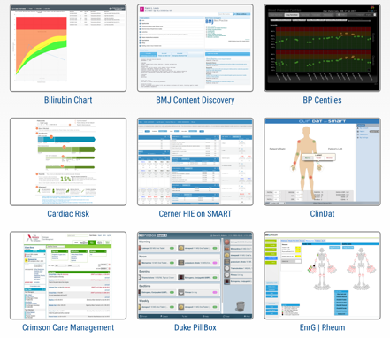
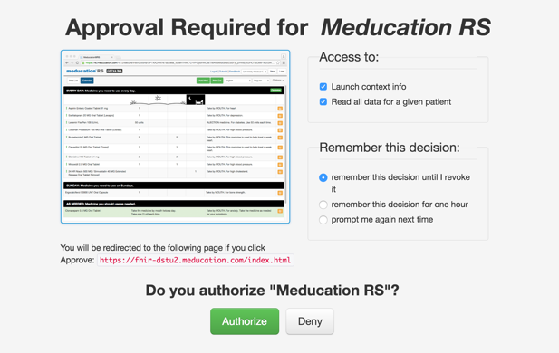
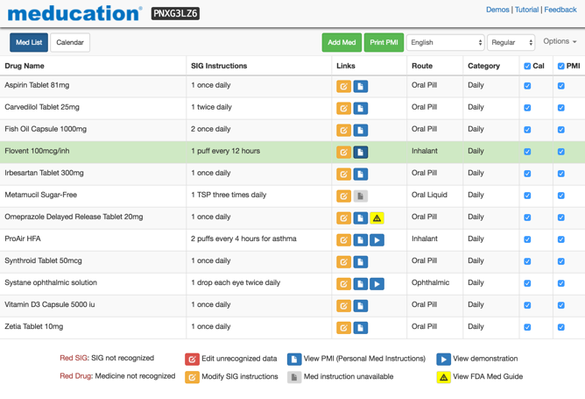
EHR Launch
App
EHR
1. Choose App
(from registered apps)
1a. Launch information (server URL, token)
1b. Data access requested (scopes)
2. Authorize Access (limited data)
2a. Auth token for data access / user identity /
context (current patient, encounter) /
extras (stylesheet, etc.)
3. Display Data
3a. FHIR API request (with auth token)
3b. FHIR resources

Slide 28
APP Ecosystem

Slide 29
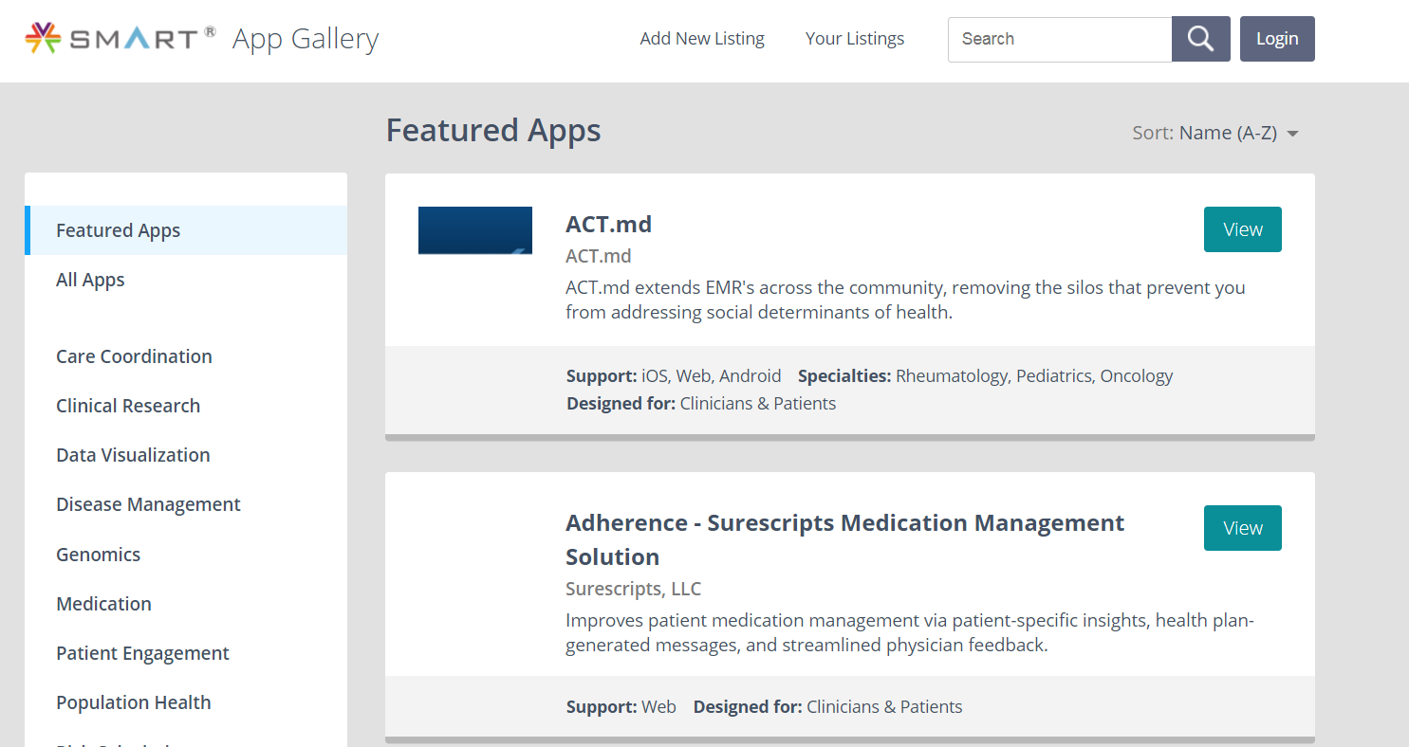
Source https://apps.smarthealthit.org/
Notes:
Clinical decisions support, population app, mobile applications, consumers applications

Slide 30
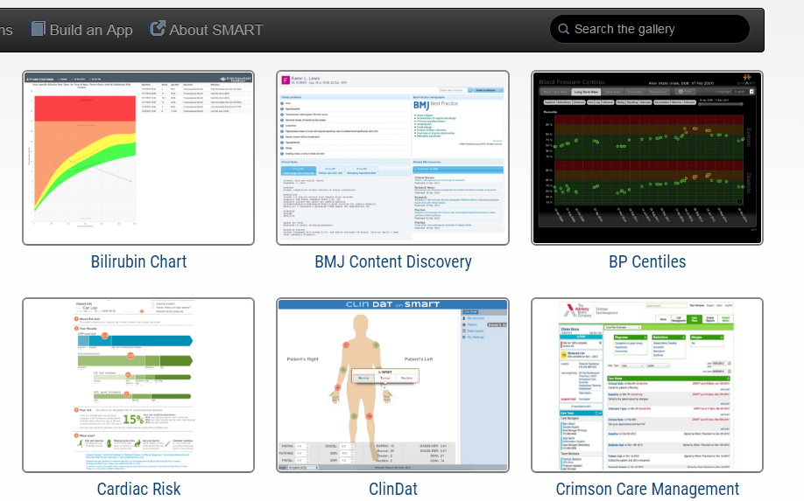
Source https://gallery.smarthealthit.org/
Notes:
https://gallery.smarthealthit.org/

Slide 31
Notes:
ClinDat – experimentation with UI
For patients, we implemented an easy-to-use interface to complete standardized questionnaires useful for monitoring rheumatic disease.
For physicians, ClinDat provides several clinical checklists (including a visual homunculus) and computes several useful rheumatologic scores.
checklist for physicians, with 28 joint electronic scoring

Slide 32
Source https://apps.smarthealthit.org
Notes:
Jaundice occurs in most newborn infants.
Most jaundice is benign, but because of the potential toxicity of bilirubin, newborn infants must be monitored to identify those who might develop severe hyperbilirubinemia and, in rare cases, acute bilirubin encephalopathy or kernicterus. condition always be preventable, cases continue to occur.
reduce the incidence of severe hyperbilirubinemia and bilirubin encephalopathy
By overlaying bilirubin [Mass/volume] results over a time-based risk chart, clinicians are presented with a visual representation of the results and associated criticality zones. By viewing the results in this way, the clinician can determine the best course of action based on the recommended intervention for the criticality of the result.

Slide 33
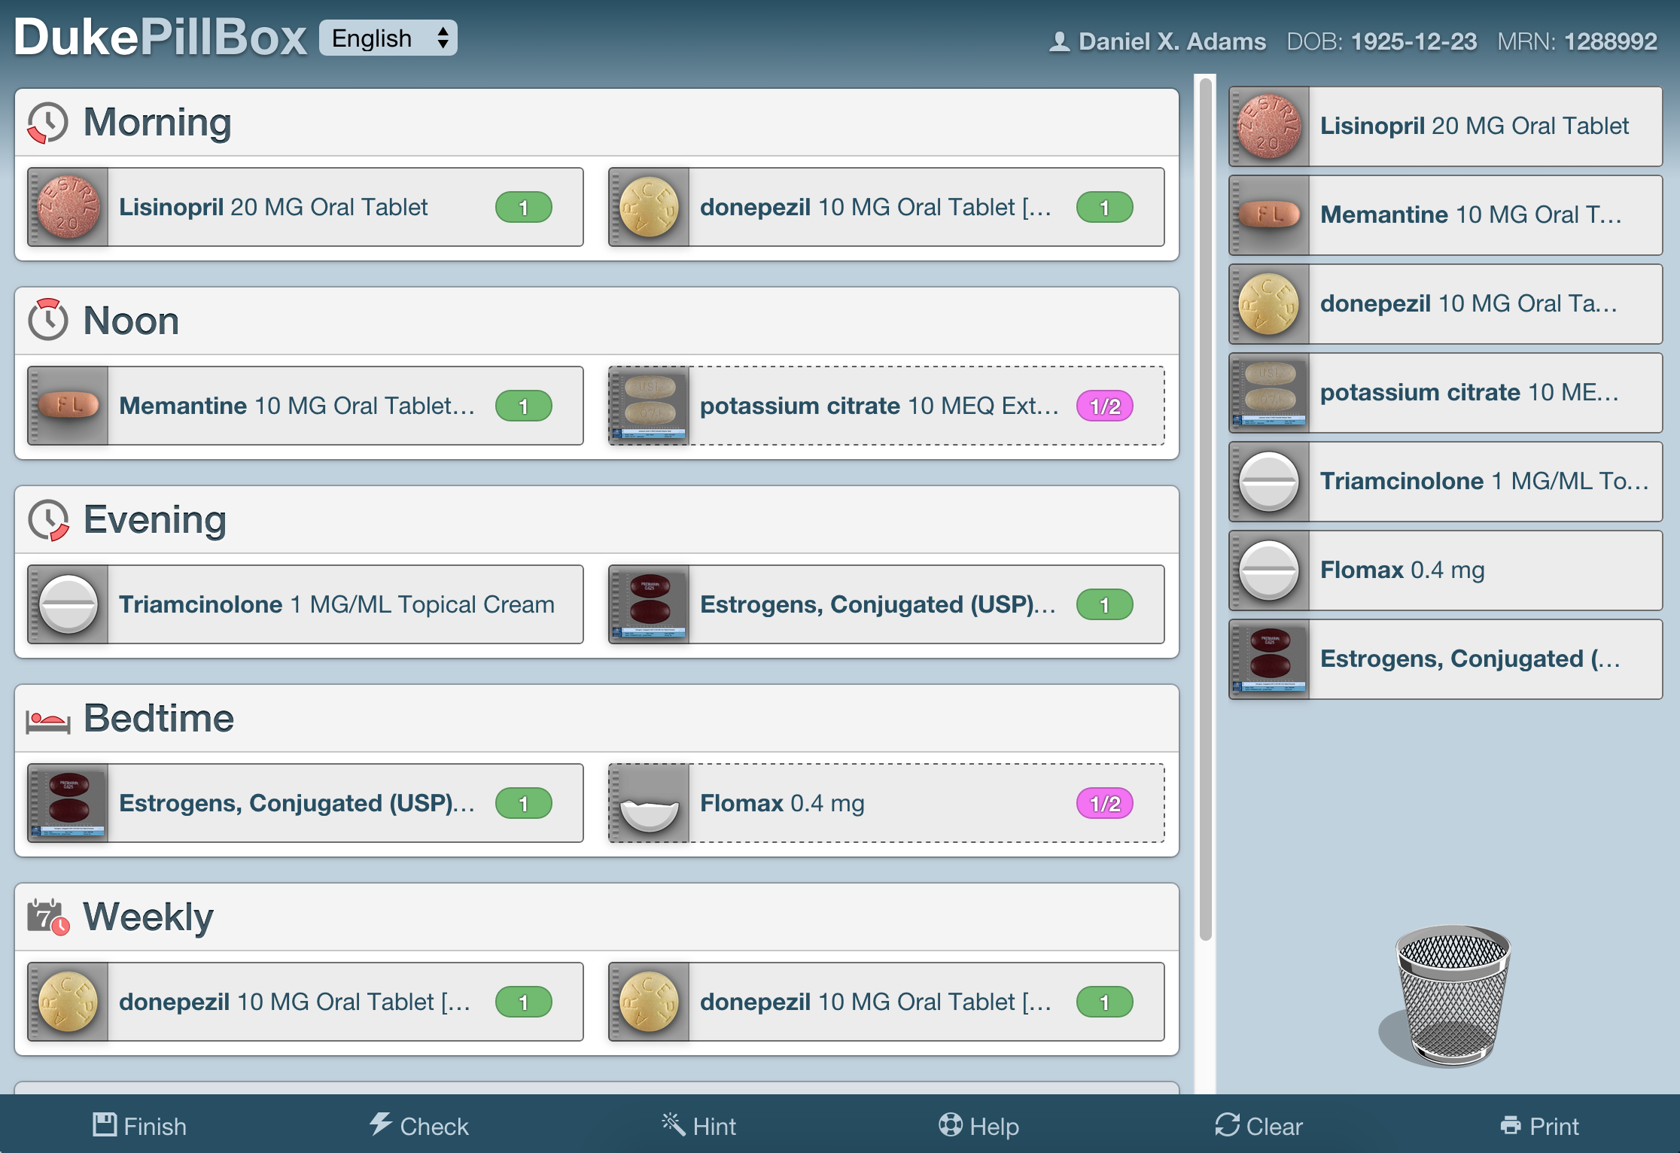
Source https://apps.smarthealthit.org/
Notes:
Duke Study – study that would have been too costly without open standards
Duke PillBox is a patient-centered, skill-based interactive learning tool designed to improve skills for medication management and patient-provider communication for med reconciliation.
Used across hospital, clinic and home settings,
offers new opportunities for data capture of patient-provider interactions related to medication use.
The app is used to teach patients the skills required to identify and organize pills in a daily and weekly medication-dosing schedule.

Slide 34
Source Mandel, Josh. “SMART An App Platform.”
Notes:
You can also add an app to the store

Slide 35
KLAS Connected Apps Report http://smarthealthit.org/apps-report
Source Mandel, Josh. “SMART An App Platform.”
Notes:
providers are looking forward to adopting solutions that will positively impact clinical outcomes
Additionally, providers are interested in the business model of an app company and how that may impact how the app is funded (one-time cost vs. subscription) and the possibility of implementation, data storage, or ongoing maintenance fees.

Slide 36
Tools and Resources

Slide 37
Software Libraries for Developers

Slide 38
Public Sandboxes for Testing

Slide 39
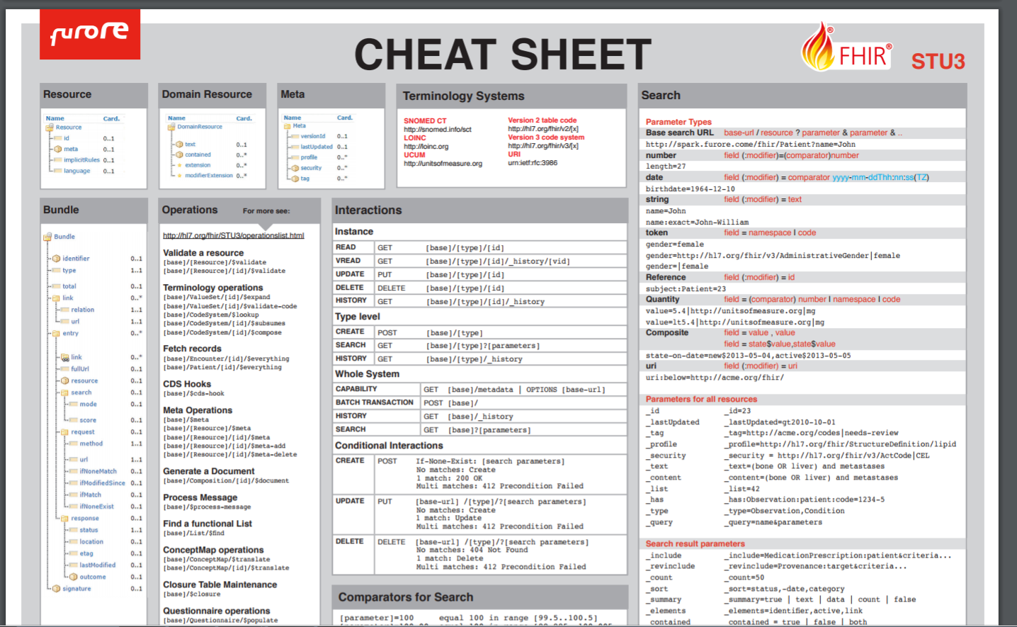
Source https://fhir.furore.com/trainineatsheet/

Slide 40
Tools and Resources
Learn More
http://docs.smarthealthit.org
https://www.hl7.org/fhir/
Vendor Sandbox Examples
fhir.cerner.com
open.epic.com
https://developer.allscripts.com/
https://apigee.com/about/solutions/apigee-health-apix
https://www.athenahealth.com/developer-portal
https://www.intersystems.com/who-we-are/our-clients-and-partners/application-partner-program/

Slide 41
Tools and Resources
Public Test Servers
http://hapifhir.io/
https://sandbox.hspconsortium.org/
http://test.fhir.org/r3
http://spark.furore.com/ http://fhirtest.uhn.ca/
http://52.72.172.54:8080/fhir/home
http://wildfhir.aegis.net/fhir3-0-1-gui/index.jsf
App Gallery
apps.SmartHealthIT.org

Slide 42
Tools and Resources
HL7 FHIR Specification
http://hl7.org/fhir/directory.html
SMART-on-FHIR (SoF) guidelines
http://docs.smarthealthit.org/
OAuth2 Dance
Authorize
Token
OpenEpic
https://open.epic.com/Account/LogOn
AppOrchard
https://apporchard.epic.com/ProgramDetails

Slide 43
Events
https://www.fhirdevdays.com/ Developer Days November 15-17 2017 Amsterdam
FHIR Applications Roundtable http://www.hl7.org/events/fhir/roundtable/2017/12/
December 5-7 New Orleans, LA
http://www.himssinnovationcenter.org/ihe-north-america-connectathon-2018
January 15-19 Cleveland, OH

Slide 44
Questions and Answers
Contact:
Adam Culbertson aculbertson@himss.org
Twitter @AdamCulby

